Slide 1
AN OVERVIEW OF THE EARLY START DENVER MODEL Cindy Dollman LeGrand, M.A., CCC-SLP/BCBA Karen Randolph, M.A., CCC-SLP
WEST VIRGINIA SPEECH-LANGUAGE HEARING ASSOCIATION CONFERENCE BRIDGEPORT WV
APRIL 5, 2019

Slide 2
BRINGING ESDM TO WEST VIRGINIA BIRTH TO THREE
Early Start Denver Model Introductory Workshop
Fall 2016 (Karen and Cindy)
Applications for WVBTT providers interested in participating in ESDM training Summer 2017
ESDM Cohort established Fall 2017
Intro class taken by 8 additional providers Winter 2017
Community of Practice established 2017
Advanced Training and continued Community of Practice August 2018
Future Plans

Slide 3
Prevalence of ASD
ASD affects up to 1 in 59 people.*
1 in 37 boys and 1 in 151 girls.
Boys are four times more likely to be diagnosed with autism than girls.
A new case of ASD is diagnosed nearly every 20 minutes.
Largest increases in Hispanic and African- American children.
Siblings of children with autism are at higher risk of developing autism
Developmental regression, or loss of skills, such as language and social interests, affects around 1 in 5 children who will go on to be diagnosed with autism and typically occurs between ages 1 and 3.
*Centers for Disease Control, 2018

Slide 4
AGE OF DIAGNOSIS
ASD can sometimes be detected at 18 months or younger.
By age 2, a diagnosis by an experienced professional can be considered very reliable.
However, many children do not receive a final diagnosis until much older. Centers for Disease Control, 2018
Current status in WV
The ESDM model offers a family friendly EBP to address the needs of our youngest citizens with autism.

Slide 5
Did You Know?
Parents identify concerns about their children by…
12-18 MONTHS
Baghdadli, Picot, Pascal, Pry, & Aussilloux, 2003
DeGiacomo & Fombonne, 1998
Tolbert, Brown, Fowler & Parsons, 2001
Notes:
The really sad thing about that statistic is that parents generally identify concerns….
In the DiGiacome and Fombonne study, parents began to recognize that their children were experiencing problems at around 19 months, with 30% noticing first abnormalities prior to the first birthday and 80% by the age of 2 years. Please note the date on that study…1998 …16 years ago
This is not new information

Slide 6
Early identification of an ASD is crucial, as it means early intervention services can begin, making a huge impact on a child’s behavior, functioning and future well-being.
Without early intervention, the symptoms of autism can worsen, resulting in more costly treatment over the course of a lifetime.
The estimated lifetime cost of caring for someone with autism ranges from $1.4-2.4 million, but this cost can be reduced by two-thirds through early diagnosis and intervention.

Slide 7
What Does Typical Social – Communication Development Look Like in infancy?
0 to 3 months: Sensitivity to and preference for faces and speech
3 to 6 months: Emergence of dyadic social interaction
6 to 9 months: More sophisticated facial processing skills, responds to name social games, more sophisticated facial processing skills
9-12 months: Social monitoring and imitation, joint attention.

Slide 8
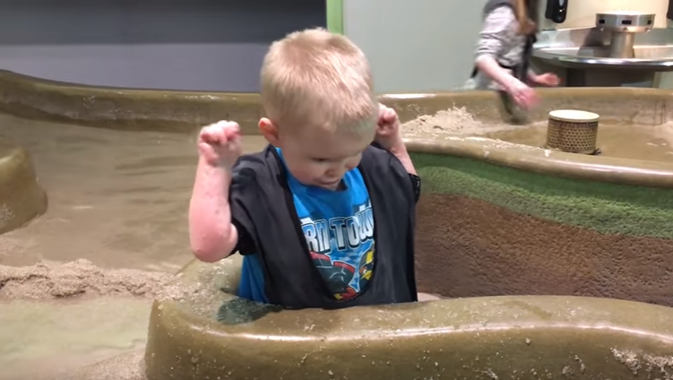
Prospective Studies
By 12-18 months children with autism differ in the following ways.
Visual tracking (↓ attention to face and eyes of others) *
Prolonged visual inspection of objects
Limited response to name *
↓ Eye contact
↓ Social Smiling
↓ Social interest
↓ Facial expression (not sharing affect with eye contact) *
Delayed gestural communication (pointing) *
Less back and forth babbling
Limited interest in toys / repetitive play
Decreased imitation
Notes:
Prospective studies ask a question and look forward. In this case, The Baby Siblings research consortium. Prospective studies are the best ways for making definitive statements about an observed phonomenon, or for deciding if an intervention is working.
Visual tracking – actually have an device that can measure this
You’ll note that repetitive and perseverative behaviors are not listed here…they can be seen but it’s subtle…also, little kids often play repetitively
This isn’t always easy….
Quality of eye contact – may be present, but fleeting. Not an absolute absence of eye contact, but diminished and
not well meshed with communicative bids or with shared affect or or a desire to share enjoyment
Babbling – one of the research consortium studies showed that high risk siblings produced fewer speech like vocalizations, fewer consonant types, and fewer consonant vowel combinations…concluded that early vocal production is a sensitive indicator of higher risk for autism. But again, determining what is “fewer” vs. not at all vs. typical can be tricky
Poor imitative learning…children are wired to imitate. If a child isn’t doing this with little gestural games “so big”, or “where’s your tummy”,
Repetitive play -This is present but subtle in kids with autism…All kids can be perseverative (example of Tessa and the questions, Lizzee lining up, and asking per-
severative quesions)
Baby Siblings Research Consortium… 21 sites that share date in United States. UK, Israel and Canada…look at siblings of children identified with autism, starting in early infancy, and evaluate them serially with standardized measures over time. 2500 siblings of children with autism, and 1500 children considered to be at low risk (no sibling with autism)
At six months, some of these behaviors were present in some children, but not persistent
By nine months, if these behaviors were observed, they tended to be persistent

Slide 9
“It’s easy to notice things babies do that are unusual.
It’s harder to notice things that are missing.”
-Dr. Lauren Turner-Brown
Notes:
If a child is flapping and spinning – they look autistic. But if the difficulties are more subtle – and they can be – they’re harder to see.
And early on – before 2 – the autistic repetitive and perseverative behaviors may not be as prominent…the differences in language and non verbal communication may be more qualitative than absolute. He does make eye contact , the parent might say, not recognizing that it’s not as robust as a typically developing child.
This is why it’s important to use tools like the ADOS – toddler module and other rigorously testing measures, where a multi specialty team is very helpful, and where multiple observations over time may be needed. Sometimes, if I am not sure about a diagnosis, I start intervention. As I tell the parents, it may not be 100% clear what the diagnosis is, but it is always possible to ID problems.
This is where making the diagnosis at these early ages becomes challenging…we’re going to talk a little more about how exactly and when pediatricians should refer for autism diagnostic evaluations, but first, here’s an important question…

Slide 10
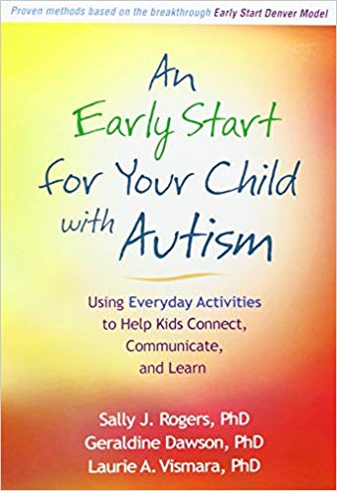

Slide 11
What is ESDM?
ESDM is a comprehensive early intervention for infants and toddlers between the ages of 12-48 months
It is a naturalistic developmental model of treatment that incorporates some teaching elements of ABA, and focuses on building strong, positive social relationships with caregivers
ESDM aims to increase the rates of development across all domains and decrease the core symptoms of autism
(Schriebman et al., 2015,
http://www.ucdmc.ucdavis.edu/mindinstitute/research/esdm/)

Slide 12
HOW DOES IT WORK?
Early interventions that enhance social attention may be critical in effecting change via brain plasticity
At the heart of the ESDM is the empirical knowledge-base of infant-toddler learning and development and the effects of early autism. If we observe how typically developing infants do most of their early learning…observational learning and imitation
The ESDM model draws on science of learning principles that cue the child’s attention to our faces, our voices and actions so we can provide very clear social communicative cues to elicit a response.

Slide 13
Theoretical Background
Developed by Sally Rogers, Ph.D. and Geraldine Dawson, Ph.D. as an extension of the Denver Model, an intervention for children with autism between the ages of 24-60 months
The American Academy of Pediatrics recommends that children be screened for autism between 18-24 months of age, so Rogers and Dawson wanted to target an intervention specifically towards that age group
(Dawson et al., 2012; Rogers & Dawson, 2010)

Slide 14
Theoretical Background con’t
The aim of ESDM is to capitalize on high levels of brain plasticity during infancy and toddlerhood
Not just to change behaviors associated with autism, but to actually change brain structure and function in order to promote future social development
Children with autism are naturally less socially-oriented, so without intervention they have less opportunities to engage in activities that will build neural pathways in the same way as typically developing children
(Dawson et al., 2012; Rogers & Dawson, 2010)

Slide 15
HISTORY OF ESDM
The Denver Model
For children aged 24-60 months, uses a developmentally-oriented curriculum to address behaviors in multiple domains. Focuses on building relationships and skills through positive, lively social interactions.
Rogers and Pennington’s Model of Interpersonal Development in Autism
A developmental model hypothesizing that children with ASD naturally lack imitation - a skill present in typically developing children from birth - which subsequently affects the development of social milestones
Social Motivation Hypothesis of Autism
Children with ASD lack sensitivity to social reward, causing a lack of interest in social activities, which leads to isolation and poor social skills
Pivotal Response Training
A method of teaching using ABA principles that aims to increase the motivation to socially engage
(Rogers & Dawson, 2010)

Slide 16
TEACHING PRINCIPLES OF ESDM
DENVER MODEL PIVOTAL RESPONSE TX ABA
Modulate arousal
Dydactic engagement
Quality of Joint Attention, Elaborated Routines
Combine Objectives
Communication in all activities, varied functions
Emphasis on NV communication
One word up rule
Follow child’s lead
Give Choices
Take turns
Maintenance interspersed with acquisition
Reinforces child attempts
Direct response-R+ relationship
Attention
ABC Format
Efficacious application of behavioral teaching techniques
Number of repetitions
Management of unwanted behavior

Slide 17
Who Participates in ESDM?
Children
Children with ASD begin the intervention between the ages of 1-3, and continue treatment until they are 4-5
Curriculum addresses developmental skills that naturally occur between 7-48 months of age
Treatment Team
Multidisciplinary team that establishes learning objectives and oversees child progress
Team members may include clinical/developmental/educational psychologists, professionals in special education, speech-language pathologists, occupational therapists, ABA specialists, and family members who receive training and direct supervision by these professionals
One lead therapist that works 1:1 with the child, other team members are available for consultation as needed
(Rogers & Dawson, 2010)

Slide 18
ESDM IS A FAMILY AFFAIR
Parental goals are a most important consideration in developing learning objectives
Parents involved in intervention process have reported greater feelings of self-efficacy and children maintain gains for a longer period
Parental training in ESDM delivery allows for continued practice of objectives in natural environments, maximizing intervention delivery
Involvement helps parents become better advocates for their children
(Rogers & Dawson, 2010; Marcus et. al, 2005)

Slide 19
Using ESDM
1:1 intensive therapy, generally 15-20 hours of therapist contact per week
Generally occurs in-home (the child’s “natural environment”) but can occur in a clinical setting, and has been adapted for group delivery
Components of the intervention:
Assessments every 12 weeks to gauge developmental skill level in all domains
Learning objectives and teaching steps targeted during play-based therapy sessions that typically last 1 hour
(Rogers & Dawson, 2010)

Slide 20
Getting Started: the Curriculum Checklist
A tool to assess developmental level and skills in a variety of domains:
Receptive communication
Expressive communication
Social Skills
Play Skills
Cognitive Skills
Fine Motor Skills
Gross Motor Skills
Adaptive Behavior Skills
Four skill levels for each domain, corresponding with specific developmental periods:
12-18 months
18-24 months
24-36 months
36-48 months
(Rogers & Dawson, 2010)

Slide 21
Curriculum Checklist
Administered in the same way as the intervention, during an interactive play-based session
Therapist engages the child in a play activity and stops every few minutes to note behaviors observed on the curriculum checklist, then resumes the session
Part of the session involves observing parent child interactions, and interviewing parents about behaviors that can’t be observed in the session
Skills at different levels marked as +, +/-, or -
(Rogers & Dawson, 2010)

Slide 22
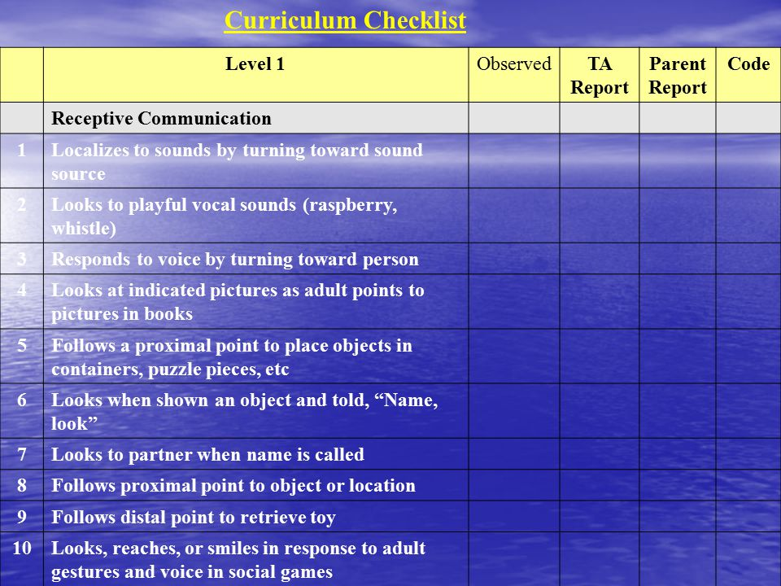
(Rogers & Dawson, 2010)

Slide 23
Selecting Learning Objectives
ESDM suggests choosing 2-3 objectives for each learning domain, even if a child has significant weaknesses in a specific domain.
Generally start with items from the Curriculum Checklist that the child performed inconsistently
Aim to complete most skills in a developmental level before working on skills in the next level
Children will work on objectives for 12 weeks, then complete a new Curriculum Checklist assessment to see how skills have progressed, and to select a new set of objectives to work on
(Rogers & Dawson, 2010)

Slide 24
Writing Learning Objectives
Written objectives contain four main components:
Specific antecedent/stimulus that will elicit target behavior
An observable, measurable behavior
Criterion defining objective mastery
Criterion defining generalization of the objective
[Antecedent:] During vocal games at home and in the clinic, [Behavior:] Andrew will spontaneously use 2-3 different vowel-consonant combinations and will vocalize [Mastery Criterion] 5 or more times in a 10 minute period [Generalization] over three consecutive sessions.
(Rogers & Dawson, 2010)

Slide 25
Teaching the Objectives
Once objectives have been defined, break them into smaller steps using task analysis
Behavior chains: A chain of behaviors that occur in a specific order
Behavior bundles: Behaviors that co-occur in order to meet the objective, but do not need to occur in a specific order
(Rogers & Dawson, 2010)

Slide 26
Teaching Strategies
During joint activity play sessions, therapists may use prompting, shaping and fading to develop target behaviors
Eliminate distractions in learning environment
Therapist positions self across from child so child has a clear view of their face and body
Observe what activities the child chooses to engage in, narrate what is happening and add sound effects
Elaborate on the play activity
(Rogers & Dawson, 2010)

Slide 27
Teaching Strategies con’t
Imitate the child, and prompt the child to imitate you
Be helpful - see what the child wants and help them obtain it. This establishes your presence as a natural reinforcer.
Control the materials - require the child to gesture or vocalize to get them from you
Take turns - when the child is engaged in a one-person activity observe, take materials and say “my turn!” then hand them back and say “your turn!”
(Rogers & Dawson, 2010)

Slide 28
What Does a Session Look Like?
Child interest cues an activity
Adult follows the child’s lead, maintaining a positive affect and using language to describe what is happening
Adult elaborates on the activity using skills such as turn taking, imitation, and variation on the play theme, while making sure the activity remains social and reciprocal
Adult weaves in target vocabulary and frequently elicits verbal and nonverbal communication from the child
It’s fun!
(Rogers & Dawson, 2010)

Slide 29
Joint Activities
Definition: An activity in which two partners are engaged with each other in the same cooperative activity, attending to the same objects
During sessions, therapists alternate between object focused and sensory-social joint routines. Sessions begin and end with “hello” and “goodbye” routines, and generally include a snack. Each joint activity typically lasts for a few minutes.
The goals of ESDM joint activities:
Engage the child in activities that provide practice opportunities for target skills
Develop a positive relationship with the child in which the adult makes activities more interesting and socially rewarding
(Rogers & Dawson, 2010)

Slide 30
Tracking Progress: the Data Sheet
For every objective, note the date started and the date the objective is passed
During each session, therapists aim to probe acquisition skills and recently mastered skills
Data marked the same way as on the Curriculum checklist (+, +/-, or -)
During a one hour session, the therapist pauses at 15 minute intervals to mark data sheet and review which teaching targets still need to be practiced
(Rogers & Dawson, 2010)

Slide 31
Troubleshooting:
When a Child is Not Progressing
Adequate progress: measurable progress on acquisition skills as reflected by data sheets, every 3-5 days for children receiving 20+ hours/week of therapy, or every 1-2 weeks for children receiving less intensive therapy
What to adjust:
Reinforcer strength
Teaching structure
Visual supports

Slide 32
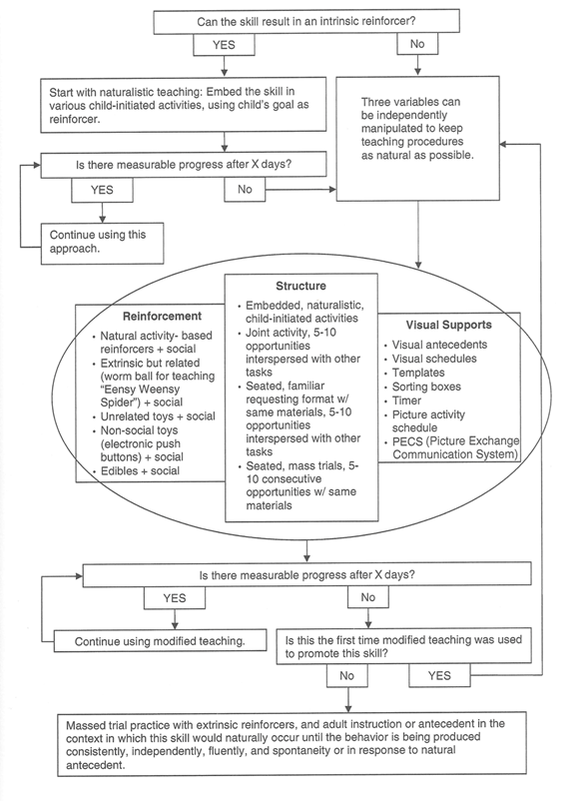

Slide 33
Early Start Denver Model:
Becoming a Play Partner:
Involves first establishing your presence as helpful and reinforcing
-and then taking a more active role in the play
Developing the play into elaborated joint activity routines
-with and without objects

Slide 34
Becoming a Play Partner
Motivation is Crucial for teaching
Demonstrated by interest and approach behavior
Watching with positive affect or interest, leaning or moving toward, or trying to attain something
Children with autism are less socially motivated than others
Attention, social approval, and “being like” others does not carry the same degree of reward or motivational value
Their interest is typical focused on the physical environment around them
Motivated to obtain objects, to handle favorite objects, to create interesting effects with objects and to go get help with objects they enjoy

Slide 35
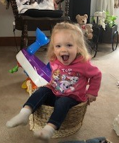
Becoming a Play Partner
We need materials and activities that stimulate child’s
interest, energy, positive affect.
A motivated child is a focused child,
attentive and
ready to learn.
FIND THE SMILE

Slide 36
Becoming a Play Partner
Strong motivation supports active learners.
Active learners show initiation and spontaneity.
TWO CHARACTERITICS THAT WE WANT TO
FOSTER IN CHILDREN WITH AUTISM

Slide 37
Becoming a Play Partner
May have a Low-Drive Child- a Child that does not approach toys
Sensory Social Toys-Object spectacles
Wind up toys-little movement
Bubbles Balloons
Pompoms Pinwheels
Beads Shakers
Maracas Bells
Toy flutes Pianos
Need to show interest, smiles, attention, or approach

Slide 38
Becoming a Play Partner
Move on to the child’s body
Play gentle or lively Physical Games
Spin Small Therapy Ball
Creepy fingers Bouncing on a Trampoline
Bouncing on knees, Hands and Feet Games
Being rolled or wrapped in a beanbag or dragged around the room in it
FIND THAT SMILE

Slide 39
Becoming a Play Partner
If Food is the only motivating object, then have a snack with the child
and uses these physical games to have a drawn-out snack time.
To be able to reach a child, you need to find reliable ways to turn on that “spotlight” of attention and the motivation behind it.
There are a few young children with autism who do not respond positively to any other stimuli
They may do better with a more adult-direct and didactic, discrete trail teaching approach to build up their interest and reward the value of interacting with objects and people. Apply the decision tree.

Slide 40
Troubleshooting: When a child is not progressing
Decision Tree-

Slide 41
Becoming a Play Partner
In order to learn from people, a child’s attention has to be on people.
We have to become the child’s focus of attention
We have to step into that “SPOTLIGHT OF ATTENTION”
Once we identify a child’s object or activity interest---
Draw the child’s attention to our eyes and faces
Our body actions
And our voices, sounds and words
BE IN THAT SPOTLIGHT

Slide 42
Becoming a Play Partner
Drawing the Child’s Attention:
Eliminating the Competition
Take Center Stage
Watch and Comment
Be Helpful

Slide 43
Becoming a Play Partner
Taking a Role in the Play:
Imitate the child
Add Variation: Elaborate the play
Becoming more Active
Control the Materials
Take Turns

Slide 44
Joint Attention Routines: Frames for Teaching
Joint Attention
An activity in which two partners are engaged with each other in the same cooperative activity,
attending to the same object
or playing or working together on a common activity
Partners maybe imitating each others, constructing the activity together (Co-constriction)

Slide 45
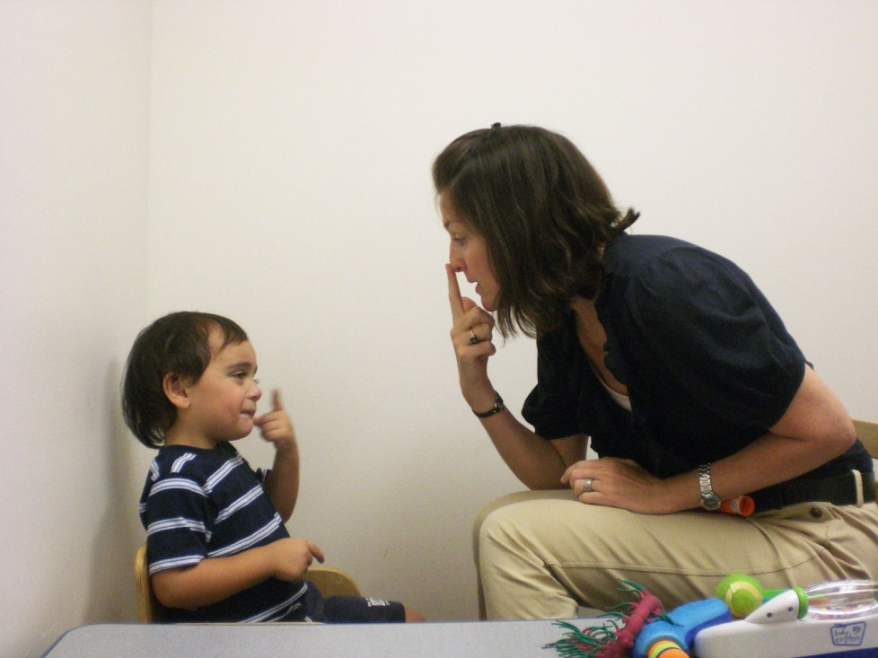
Joint Attention Routines
Joint Activity Routines are the frames for teaching in the ESDM
The social element of a joint activity is richest teaching tool!
In Joint Activities:
partners look at each other,
give each other materials,
imitate each other,
communicate with each other,
and share smiles and fun!

Slide 46
Phases of Joint Activity Routines
The term Joint Activity Routines-discuss the entire scenario that surrounds the play acts with a social partner and provides for a whole teaching activity
Several phases:
The Opening or Set-Up Phase
The Theme
The Elaboration Phase
The Closing
Involves a series of joint activities, beginning with a greeting activity, then moving through a series of different activities, some more active, some at the table, some more object focused and some more social, until the closing greeting routine ends the treatment session.

Slide 47
Object-Based Joint Activities
Materials Provide the Play Theme
Both the Child and the Adult are attending to actions on objects, and the social element is woven into the actions on objects through all techniques described above:
Imitations
Turn taking
Management of materials
And variation

Slide 48
How to Do Joint Activities with Objects
Narrate the activity as you follow the child's lead by naming objects, actions, and relations in the simple language.
Should occur frequently-several times a minute-This is the giving, the sharing, the showing, the pointing and the looking back and forth.
As one theme or action becomes “played out”
Move to the elaboration phase
Model new action occasionally
When the interest fades-
Move through clean-up phase
New material and another joint attention routine

Slide 49
Partner-Focused Joint Activities: Sensory Social Routines
The term sensory social routines
refer to joint activity routines in which each partner's attention is focused on the other person,
rather than the object
where there is mutual pleasure and engagement dominate the play.

Slide 50
Partner-Focused Joint Activities: Sensory Social Routines
Sensory Social Routine is a Dyadic Activity:
Two persons are engaged in the same activity in a reciprocal way
Turn Taking
Imitating Each Other
Communication
Gestures
Facial Expressions
Building on Each Others Activity

Slide 51
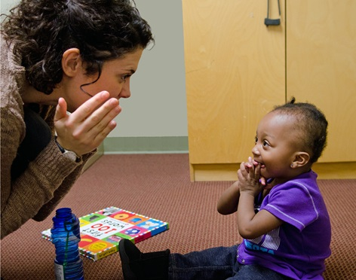
Partner-Focused Joint Activities: Sensory Social Routines
Objects are incidental-The theme of the joint activity is the social exchange
Typical sensory social routines:
Lap games: “Peek-a-Boo,” “Up…Down,”
Songs with Motions: “Itsy Bitsy Spider,” “Wheels on the Bus,”
Floor Songs: “Motorboat,” “Ring around the Rosy”
Finger Play: Creepy Fingers”
Movement Routines: “Airplane,” “Swing,” “Chases,” “Hide and Seek”

Slide 52
Four Main Goals that Sensory Social Routines accomplish:
Drawing the child’s attention to other people’s social communicative cues- especially eye contact and the face physical gestures, postures, anticipatory movements, and facial expressions.
Developing the child’s awareness of facial expression and their ability to share emotional expression face to face with another.
Increasing the child’s communication to initiate, respond to, and continue social interaction through their eye contact, facial expression, gestures, sounds, and words.
Optimizing the child’s arousal, state, and attention.

Slide 53
Sensory Social Routines-Foster Social Orienting and Communication
Sensory Social Routines teach children to communicate intentionally to initiate, maintain, and end social interactions. Adult sets up interesting activities until the child is engaged, and then pause and wait for the child to signal them to continue.
Very subtle at first: involving looking, reaching, vocalizing, making eye contact, or making some other gestures.
This signal marks the child’s “Turn”
and the adult then responds by continuing the activity.

Slide 54
Sensory Social Routines Optimize Attention and Arousal for Learning
Type of touch, movement, and rhythm
that the adult uses
in the sensory social routine
has a fairly immediate effects on the child.

Slide 55
Alternating between Object-Focused Joint Activities and Sensory Social Routines
Object focused routines provide a teaching platform for:
Cognitive skills
Imitation
Communication and language
Fine motor
Toy play skills
Sensory Social routines focus on:
Social skills
Communication and language skills
Imitation skills

Slide 56
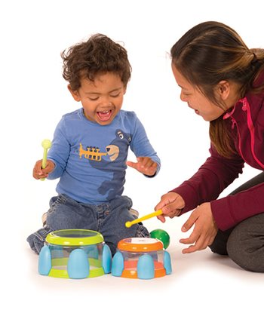
Developing Skills
Developing Imitation Skill
Vocal Imitation
Most important skill we can teach
Hardest skill to teach
Highly arousing sensory social activities
Imitate those vocalization immediately and provide reinforcements
Vocal rounds
Increase different vocalizations
PROMPTS
Or another means of functional communications

Slide 57
Families
Most Important People in the Child’s Development
Using Everyday Activities to Help Kids Connect,
Communicate, and Learn
Meal time
Play times-toy
Sensory times
Caregiving times
Reading time
Household chores
Bath time

Slide 58
Typical Sequence of Activities for and Hour Session
Activity What Activity Objectives
Greeting Hello Routine Social, Communication, imitation
Object-Activity Puzzle Fine motor, cognitive, play, Communication objectives
Sensory Social Ring around the rosy Social, Imitations, Communication,
Motor movement Throwing a ball Imitation, Gross Motor,
Object activity Block tower Imitation, Cognitive, Communication,

Slide 59
Typical Sequence of Activities for and Hour Session-continued
Activity Activity Objectives
Sensory social Popping stamping on bubbles Social, Imitation, Communication
Snack Using a Fork with Fruit Pieces Self-care, Communication, Imitation
Motor Movement Rolling a Therapy Ball Motor, Social, Communication, Motor
Books Animal Touch/Sound Book Joint Attention, Social, Communication
Object Activity Rhythmic Band Music Social imitation, Communication, Play
Greeting good-bye Closing Song Social, Communication, Imitation

Slide 60
QUESTIONS?

Slide 61
REFERENCES
Collaborative START Lab Overview, UC Davis MIND Institute. http://www.ucdmc.ucdavis.edu/mindinstitute/research/esdm/
Rogers, S. J., & Dawson, G. (2010). Early Start Denver Model for Young Children with Autism: Promoting Language, Learning, and Engagement. New York: Guilford Press.
Rogers, S. J., & Dawson, G., Vismara, L.A. (2012). An Early Start for Your Child with Autism. Using Everyday Activities to Help Kids Connect, Communicate and Learn. New York: Guilford Press.
Schreibman, L., Dawson, G., Stahmer, A., Landa, R., Rogers, S., McGee, G., Kasari, C., Ingersoll, B., Kaiser, A., Bruinsma, Y., McNerney, E., Wetherby, A., & Halladay, A. (2015). Naturalistic Developmental Behavioral Interventions: Empirically Validated Treatments for Autism Spectrum Disorder. Journal of Autism and Developmental Disorders. 45. 2411-2428.
UC Davis MIND Institute ESDM Training Program. http://ucdmc.ucdavis.edu/mindinstitute/research/esdm/pdf/certification_steps.pdf

Slide 62
RESOURCES
http://www.wvdhhr.org/birth23/
https://www.autismspeaks.org/
http://mountaineerautismproject.org/
https://www.bacb.com/bcba-eligibility-requirements-january-2022/

Slide 63
Resources con’t
Center for Evidence Based Practice: Young Children With Challenging Behavior (TACSEI) www.challengingbehavior.org
The Center on the Social and Emotional Foundations for Early Learning (CSEFEL)www.CSEFEL.vanderbilt.edu
Zero to Threewww.zerotothree.org
CDC – Learn the Signs. Act Early www.cdc.gov/actearly

Slide 64
WE NEED MORE BEHAVIOR ANALYSTS
https://www.bacb.com/bcba-eligibility-requirements-january-2022/
BCBA Requirements (January 1, 2022) Eligibility Requirements:
Pathway 1 – Association for Behavior Analysis International (ABAI) Accredited Program:
A degree from an ABAI-accredited master’s or doctoral program
Practical experience that meets the 2022 fieldwork requirements
Pathway 2 – Coursework:
315 hours of specific graduate coursework in behavior analysis (see below)
A master’s degree or higher in any field of study
Practical experience that meets the 2022 fieldwork requirements

Slide 65
CONTACT INFORMATION
Karen Randolph: kdrandolph2@yahoo.com
Cindy LeGrand:
cidole2@gmail.com

Slide 66
MAP 2019 Conference: Early, Intensive, Effective Intervention
Friday, April 12, 2019 at 8:30 AM – 5:30 PM The Blennerhassett Hotel 320 Market St, Parkersburg, West Virginia 26101

